Slide 1

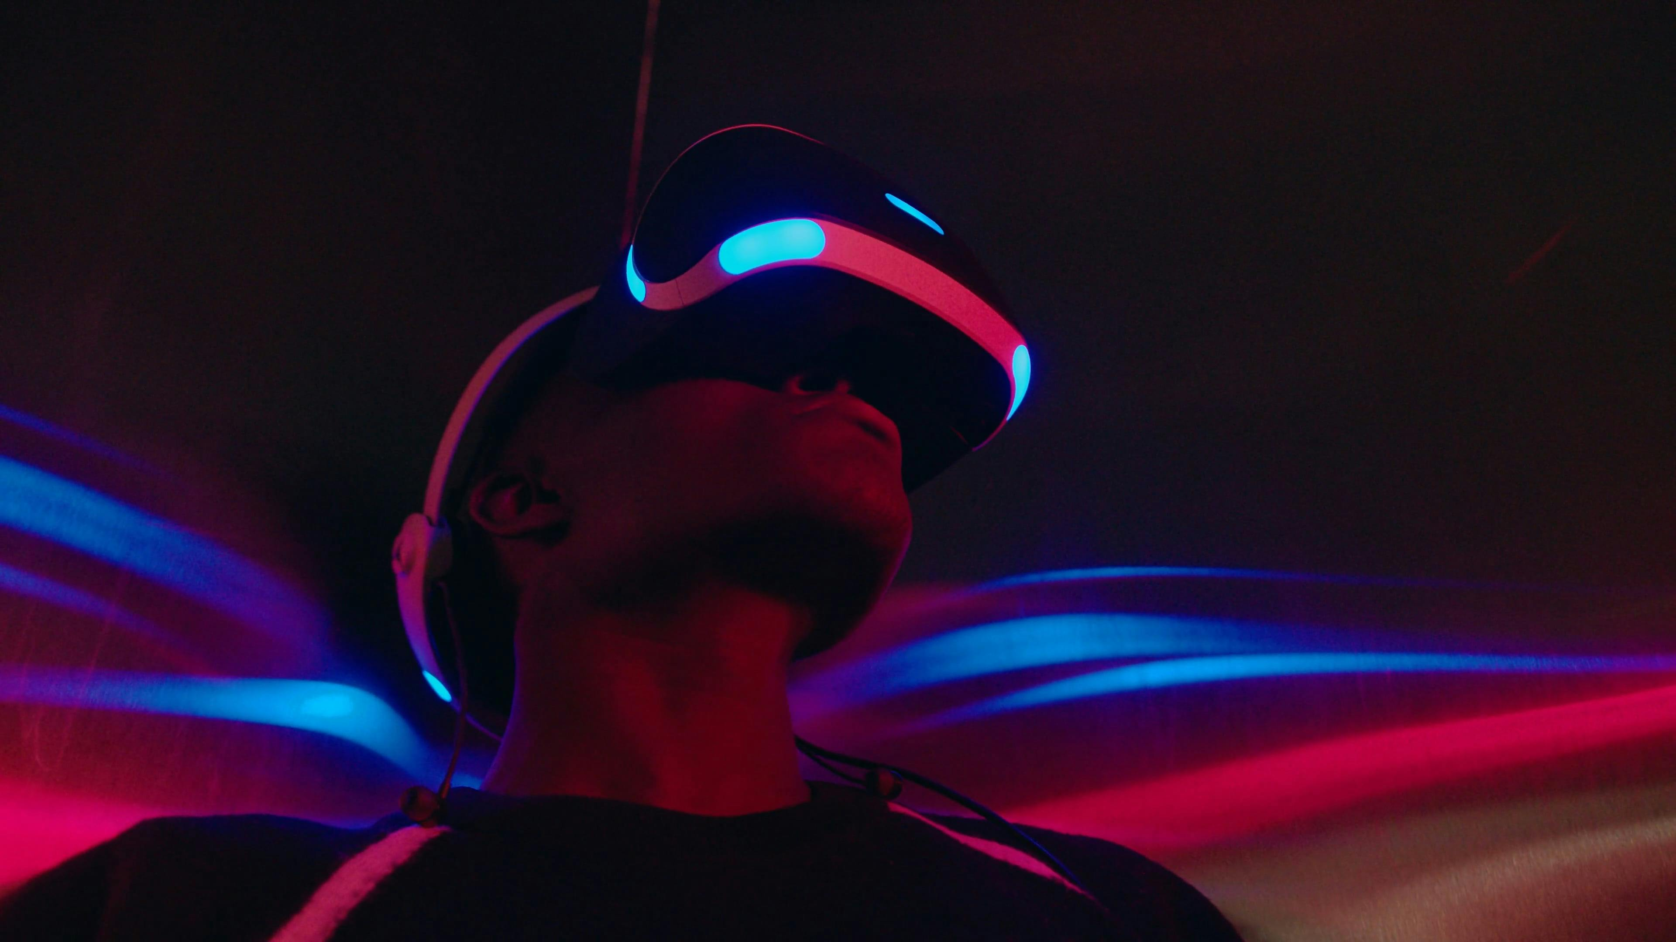
AR ACCESSORIES
MCA 2023-2024
Major Project
Project Supervisor:- Dr. Ankit Verma Sir

Slide 2

TEAM MEMBERS
TARUN KUMAR
(Team Leader)
2200290140159
TANYA TYAGI
(Team Member)
2200290140158
VAIBHAV KUMAR
(Team Member)
2200290140171

Slide 3
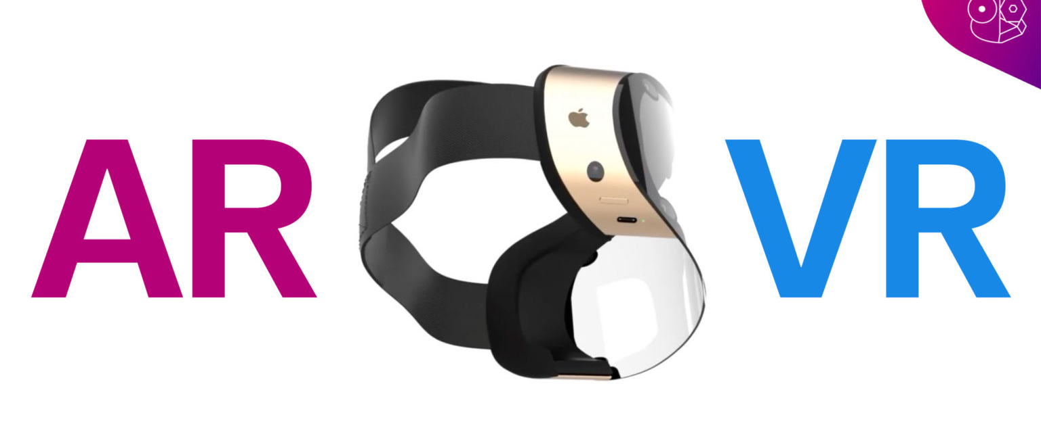
INTRODUCTION

Slide 4
INTRODUCTION
Augmented reality is an interactive experience of a real-world environment where the objects that reside in the real world are enhanced by computer-generated perceptual information, sometimes across multiple sensory modalities, including visual, auditory, and olfactory.
It is a good way to render real world information and present it in an interactive way so that virtual elements become part of the real world.
A simple augmented reality use case is a user captures the image of a real-world object, and the underlying platform detects a marker, which triggers it to add a virtual object on top of the real-world image and displays on your camera screen.
AR Accessories Application is based on Augmented Reality (AR) to show the implementation of different items in real world through a scanned code which can also used in education, and healthcare to implement their products. The technology used in this project is Unity Engine/Android Studio to create the application for this project.
AR Accessories is a try on app which is presently working on shopping items only, but in future it can be used for multipurpose use in different fields.
AR Accessories is an augmented reality try-on app that allows peoples to quickly see how a particular sneaker looks on him, without having to visit a physical store.

Slide 5

TECHNOLOGIES/ SOFTWARE REQUIREMENTS
Software used to create AR Accessories
Unity:- Unity is a cross-platform game engine developed by Unity Technologies, to support a variety of desktop, mobile, console and virtual reality platforms.
Vuforia:- Vuforia is an augmented reality software development kit for mobile devices that enables the creation of augmented reality applications.
VS Code:- Visual Studio Code, also commonly referred to as VS Code, support for debugging, syntax highlighting, intelligent code completion, snippets, code refactoring, and embedded Git.

Slide 6
HARDWARE REQUIREMENTS
To use AR Accessories Application user Hardware requirements are:-
Hardware Requirements
Smartphone with AR capabilities (Camera Enabled)
To run the Android Application (Smartphone with Android OS)
Able to scan the QR Code Clearly
100-200MB Storage Space

Slide 7
MODULE DESCRIPTION
Different Modules for the AR Accessories Application
3D Modeling (Vuforia)
Coding For Implementation
Sneaker Try-On Module: Allows users to virtually try on different sneakers
Watch Try-On Module: Enables users to see how different watches look on their wrists
Workout Clothes Try-On Module: Allows users to visualize different workout clothes on their body
C#:- C# is a general-purpose high-level programming language supporting multiple paradigms. C# encompasses static typing, strong typing, lexically scoped, imperative, declarative, functional, generic, object-oriented, and component-oriented programming disciplines.
Implementation of 3D models to an application which allows user to try- on the different products.

Slide 8
MODULE DESCRIPTION
Different Modules for the AR Accessories Application
UI Development for Application
User Interface Module: Provides an intuitive and user-friendly interface for seamless navigation.
In this module the look of the Application is decided to look user friendly.

Slide 9

WORKING PROCEDURE
This app works on target image recognition. First, we’ve to set a target image which will be detected by our app and on the top of that image our unity model will be placed.

Slide 10
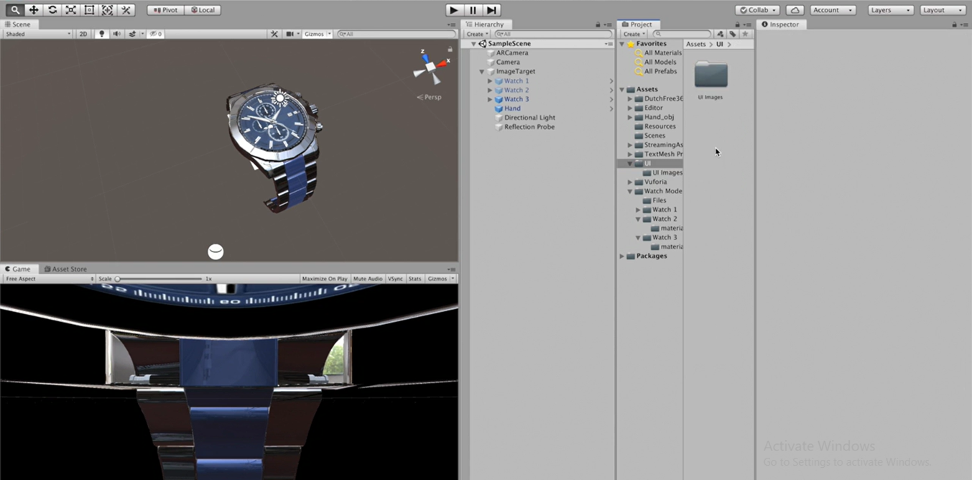
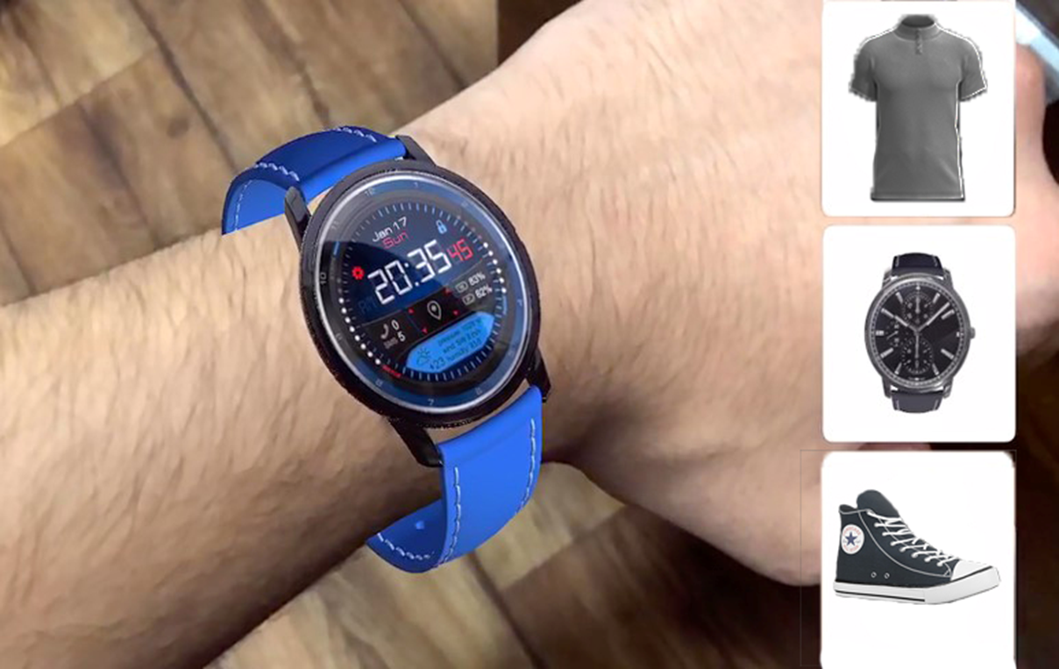
OUTPUTS

Slide 11
CONCLUSION
In conclusion, augmented reality is a powerful technology with the potential to transform the way we interact with the world around us. While there are still challenges to be addressed, the benefits of AR are clear, and we can expect to see continued innovation and growth in this exciting field in the years to come.
AR Accessories provide convenient way to try on the products before using them which gives users idea to buy that product or not, right now it only works for shopping products but in future it works in different fields.
Through the seamless integration of AR technology, AR Accessories not only empowers users to make informed purchasing decisions but also fosters a more immersive and engaging shopping experience. With just a few taps on their smartphones, users can visualize how different products look and fit on their bodies, enabling them to explore various options and find the perfect match with ease.

Slide 12
GANTT CHART

Slide 13
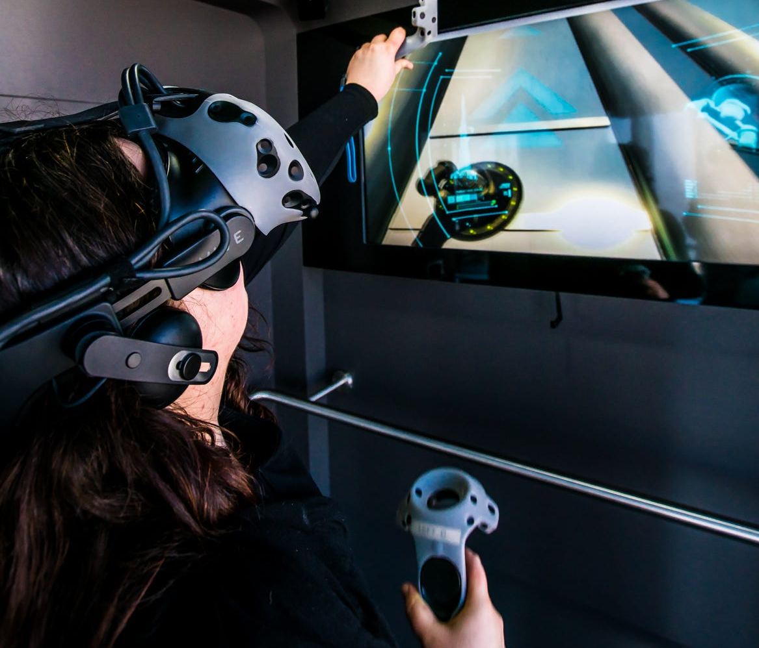
THANK YOU!

